Slide 1
Visual Perception & Information Design for the Mind
Week 20, 08.02.2016
Dr. Elena Simperl
Data Visualisation (COMP6234)

Slide 2
Session Aims
Visual perception
How the human eye works
How the brain can be tricked or lied to
Types of colour-blindness
Information design for the mind
How the brain notices differences
Pattern recognition
Elementary perceptual tasks
Memory and recognition

Slide 3
VISUAL PERCEPTION

Slide 4
Visual Perception
Seeing – perceiving – knowing
Very different phenomena
The eye and brain work together to help you understand things around you
Knowing
Seeing
Perceiving

Slide 5
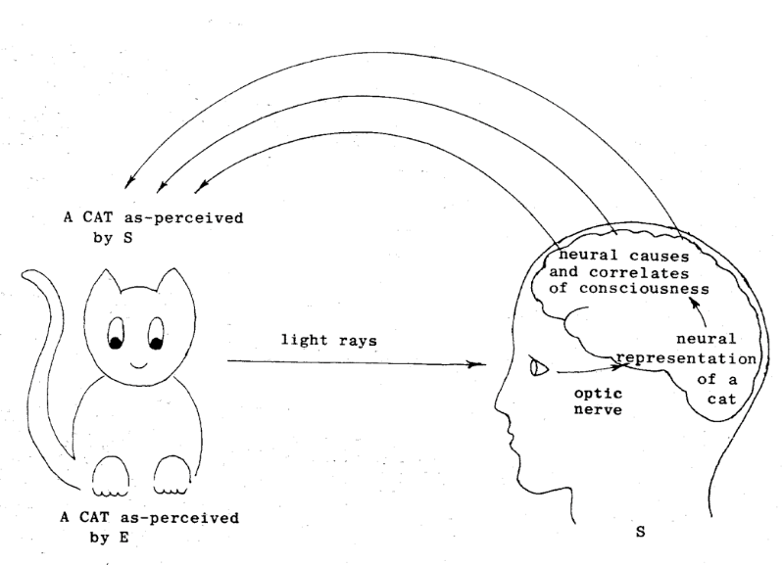
The Inner Workings of the Eye
Image from slides provided by Max van Kleek

Slide 6

The Inner Workings of the Eye (2)
Eyes – camera lens
Optic nerves – cables
Brain – microprocessor and hard drive
Understanding how the eye and brain work allows us to communicate stories from data more effectively
Image: https://www.qut.edu.au/study/short-courses-and-professional-development/short-courses/robotic-vision

Slide 7
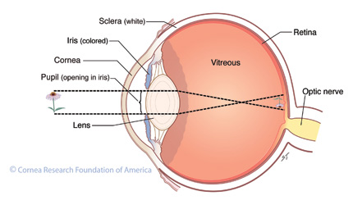
Retina is made up of rods and cones
Photoreceptors that detect light
Rods: 100 million, detect black and white, active in dim light
Cones: 7 million, detect colour
http://www.cornea.org/getattachment/Learning-Center/What-is-a-Cornea/crosssection-of-eye-co-works.jpg.aspx

Slide 8
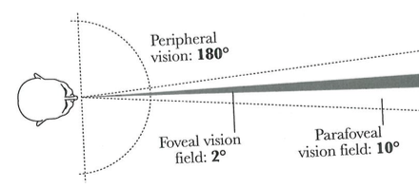
Peripheral Vision
Foveal field of vision is about 2 degrees and is what we see in full detail
Centred around the ‘fovea’, see blue circle on diagram – just cones
Parafoveal field is 10 degrees – sparser cones
Remainder is peripheral vision: 180 degrees, only detected by rods

Slide 9

Peripheral Vision (2)
Eyes are constantly moving, focusing on different areas very quickly (saccadic movement)
The sum of all movements builds up an image for your brain of what you are seeing
Moving objects, uncommon shapes, and bright colours will attract more attention: from evolution!
You want to pay attention when predators are walking towards you!

Slide 10
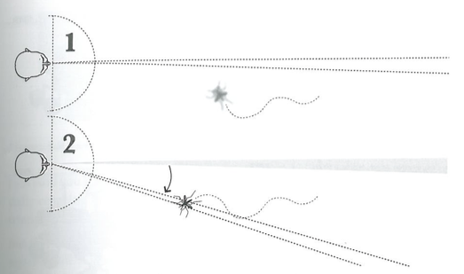
Peripheral Vision (3)
Eyes are constantly moving, focusing on different areas (saccadic movement) to build up an image for your brain of what you are seeing
Cairo: The Functional Art, p 105

Slide 11
Prioritising Information
Simultaneously showing animation and text can confuse the viewer – the animation is moving and the text is in ‘uncommon’ shapes
The brain won’t know what to focus on
Pure colours are uncommon in nature – so avoid and only use to highlight something important
Knowing how the brain prioritises information means we can prioritise how things are displayed in visualisations

Slide 12
Lying to the Brain
Quickly look at the next slide
What do you see?

Slide 13

http://thebrainbank.org.uk/teaching-materials/brain-function/illusions/

Slide 14
Who saw a white square over four black circles?

Slide 15
Your Brain is Deceiving You!
There is no white square.
Remove the 4 ‘pacman’ shapes, and there is nothing there!
Your brain is making assumptions based on what it knows about the world already
“Empty areas” don’t exist
The brain ‘perceives’ more than what the retinas see

Slide 16
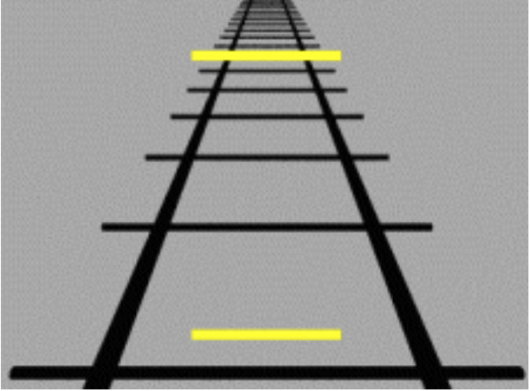
Which yellow line is longer?
http://thebrainbank.org.uk/wp-content/uploads/2012/08/Ponzo_illusion.gif

Slide 17
Which yellow line is longer? (2)
http://thebrainbank.org.uk/wp-content/uploads/2012/08/Ponzo_illusion.gif

Slide 18
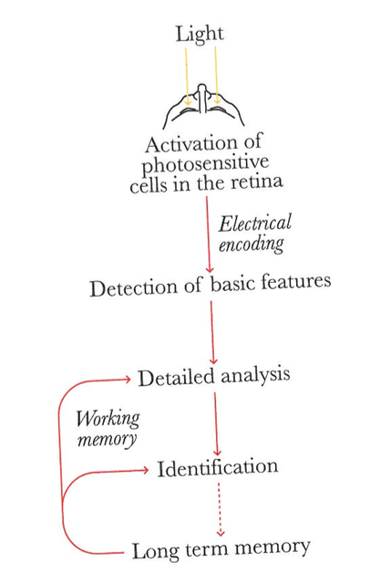
How Perception Really Works
Cairo: The Functional Art, p 110

Slide 19
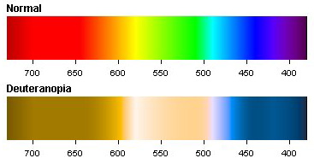
Not Everyone ‘Sees’ in the Same Way
8% of males suffer some form of colour-blindness
This reduces the spectrum of coloured light that can be seen or perceived
E.g., Deuteranopia: 5% of males
http://www.color-blindness.com/wp-content/images/deuteranopia-color-spectrum.jpg

Slide 20
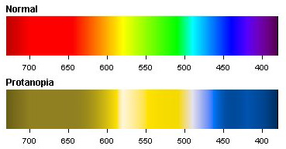
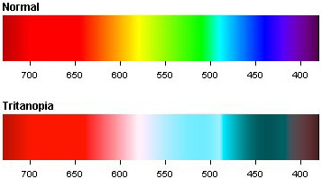
1% of all males

Slide 21
Colour
Colour can be dangerous to rely upon within visual design
For critical use cases (e.g. traffic lights), how is this problem solved?

Slide 22
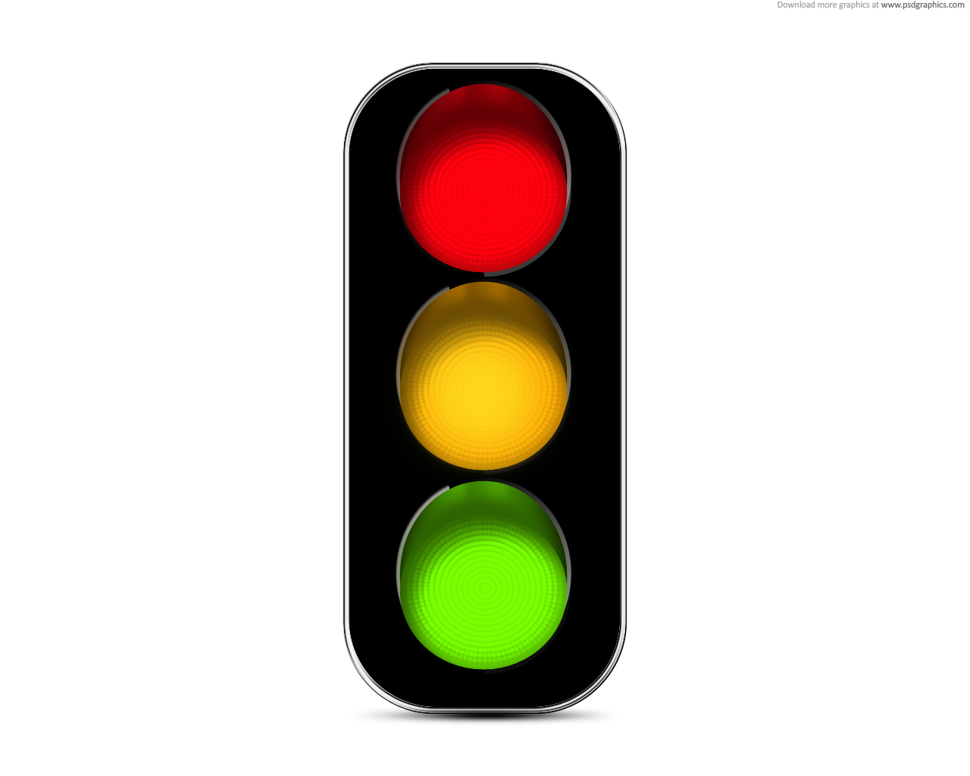
Colour (2)
Colour can be dangerous to rely upon within visual design
For critical use cases (e.g. traffic lights), how is this problem solved?
Consistent positioning

Slide 23
Information design for the mind
“Anticipating What the Brain Will Do”

Slide 24
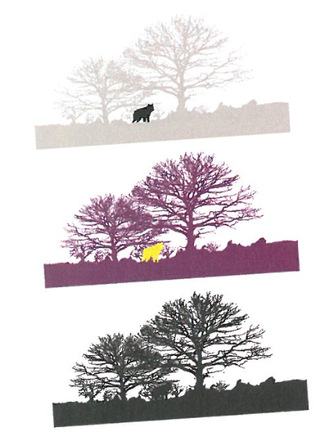
Detecting Differences
In the first two images, differences between object and background are identified
You don’t know immediately that you’re seeing a wolf
But you see something relevant, and fix your gaze on it
Cairo: The Functional Art, p 112

Slide 25
Detecting Differences (2)
Shade variations are easier to perceive
Shape variations are harder to perceive
The wolf is much harder to see in the third image
Cairo: The Functional Art, p 112

Slide 26
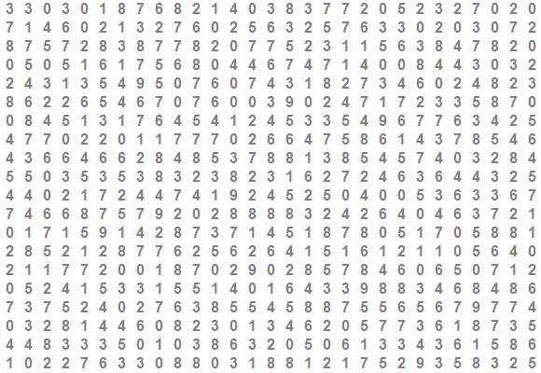
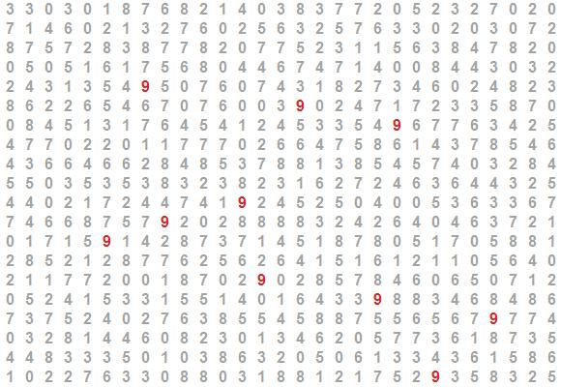
Detecting Differences (3)
Shade variations are easier to perceive
Shape variations are harder to perceive
Recall this example from Lecture 1: It is much easier to identify how many 9s are in the data from the 2nd image

Slide 27
Gestalt Theory: Pattern Recognition
School of thought from German psychologists in 1930s/40s
Refers to ‘patterns’ and emergent structures
The brain and visual system follow certain principles for perceptual organisation
How it groups elements into ‘patterns’

Slide 28
Gestalt Theory: Principles of Organisation
Proximity – objects that are close are perceived to be natural groups

Slide 29
Gestalt Theory: Principles of Organisation (2)
Similarity – identical or similar objects belong to a group

Slide 30
Gestalt Theory: Principles of Organisation (3)
Connectedness – linking using a line or similar

Slide 31
Gestalt Theory: Principles of Organisation (4)
Connectedness – linking using a line or similar

Slide 32
Gestalt Theory: Principles of Organisation (5)
Continuity: Smooth contours are easier to perceive than sharp angles
Person 1
Person 2
Person 3
Person 1
Person 2
Person 3

Slide 33
Gestalt Theory: Principles of Organisation (6)
Closure: bounded areas indicate a grouping

Slide 34
Gestalt Theory: Takeaway Message
Graphics can be made more functional using simple techniques around organisation and layout of components
Conversely, not using Gestalt principles correctly might mislead users as they will make wrong assumptions about the components you display

Slide 35
Visual Perception & Graphic Forms
1984: Cleveland and McGill paper in Journal of the American Statistical Association
Mostly still relevant after 30 years
Proposes basic guidelines for choosing a graphic form
Authors listed and ranked 10 ‘elementary perceptual tasks’ (see next slide)

Slide 36
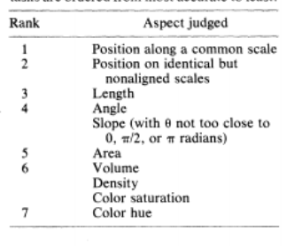
Cleveland and McGill’s Theory
A system of elementary perceptual tasks
A ranking of graphic properties based on the ability of humans to understand the information conveyed, detect differences, and compare

Slide 37
Cleveland and McGill’s Theory (2)
A graphical form that involves elementary perceptual tasks that lead to more accurate judgements than another graphical form (with the same quantitative information) will result in a better organization and increase the chances of a correct perception of patterns and behavior.”
If the reader needs to make an accurate comparison, a graphical form near the top of the list should be used.

Slide 38
Choosing a Graphic for Visual Perception
Question:
For a precise comparison, which type of chart would be most accurate?
Bar chart?
Bubble chart?
Heat map?

Slide 39
Choosing a Graphic for Visual Perception (2)
Question:
For a precise comparison, which type of chart would be most accurate?
Bar chart?
Bubble chart?
Heat map?

Slide 40
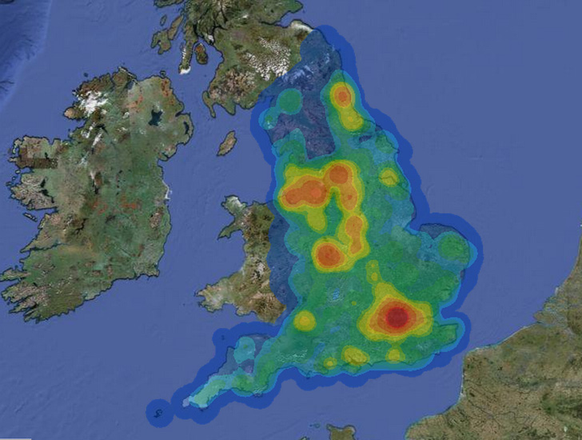
Choosing a Graphic for Visual Perception (3)
When precision is less important, lower ranked visual forms can be used well
E.g., spotting larger patterns

Slide 41
Choosing a Graphic for Visual Perception (4)
When precision is less important, lower ranked visual forms can be used well
E.g. spotting larger patterns
But really difficult to compare two similar areas!

Slide 42
How does all this Help us make sense of the world?

Slide 43
Memory
During ‘visual perception’ the brain’s visual processing areas receive information from two sources:
Impulses from the retinas (what your eyes are seeing)
Bottom-up processing
Contents from memory
Top-down processing
The combination allows us to recognise objects, and to ‘know’ what they are.

Slide 44
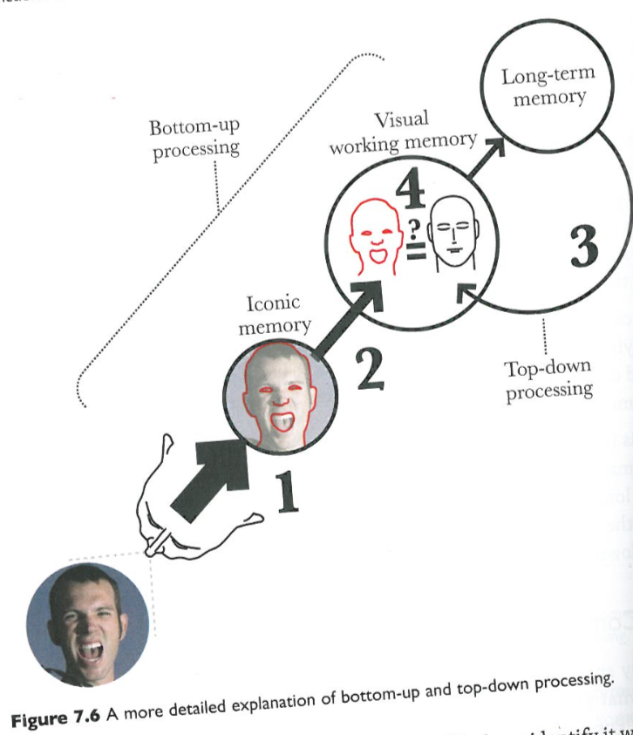
Memory (2)
Brain compares what you see with what you already know and remember.
When it finds a match, it has identified the object.
Or makes it think it has seen a face in clouds!
Cairo: The Functional Art, p 140

Slide 45
Information Design for the Brain
Removing irrelevant information improves identification because the brain has to work less to extract and detect them.
Ryan and Schwartz (1956) found that participants were able to identify images from a line drawing faster than a shaded illustration, or a photograph of the same scene
Why? There is less irrelevant information included in the line drawing.

Slide 46
Information Design for the Brain (2)
When designing a graphic to explain something the visual should be:
Simplified
Abstract
Non-realistic
Free of clutter and texture.
See also data-to-ink ratio by Tufte.

Slide 47
Summary
From understanding how the eye and brain work together to ‘see’, we’ve uncovered a number of ways to make visualisations more effective

Slide 48
Summary: Takeaway Points
1. Simultaneously showing animation and important text can confuse the viewer.
2. Colour is dangerous to rely upon. Other visual elements should complement it to enhance the message.
3. Shade variations are easier to spot than shape variations.
4. Following Gestalt Theory, graphics can be made more functional using simple techniques around organisation and layout of components.

Slide 49
Summary: Takeaway Points (2)
5. When making comparisons between data points, higher ranked visual encodings should be used, e.g., position.
6. Removing irrelevant information improves identification because the brain has to work less to extract and detect them.
Diagrams explaining things should therefore be simple and abstract, rather than based on photographs

Slide 50
Further Reading
Key text for this lecture:
Cairo, Alberto. The Functional Art: An introduction to information graphics and visualization. New Riders, 2012.
Chapters 5 – 7
Suda, Brian. A Practical Guide to Designing with Data. Mark Boulton Design Limited, 2010.
Cleveland, W.S. and McGill, R., 1984. Graphical perception: Theory, experimentation, and application to the development of graphical methods. Journal of the American statistical association, 79(387), pp.531-554.
Ryan, T.A. and Schwartz, C.B., 1956. Speed of perception as a function of mode of representation. The American journal of psychology, 69(1), pp.60-69.

